Slide 1

Tabu Search
Glover and Laguna, Tabu search in Pardalos and Resende (eds.), Handbook of Applied Optimization, Oxford Academic Press, 2002
Glover and Laguna, Chapter 3 in Reeves, Modern Heuristic Techniques for Combinatorial Problems, Wiley, 1993

Slide 2

Background of TS
TS has its roots in methods that cross boundaries of feasibility and local optimality
Examples of such methods include use of surrogate constraints and cutting plane approaches
TS was first proposed by Glover (1986) and was also developed by Hansen (1986)

Slide 3
Basic notions of TS
The word tabu (or taboo) comes from Tongan, a language of Polynesia, where it indicates things that cannot be touched because they are sacred
Now it also means “a prohibition imposed by social custom”
In TS, tabu status of forbidden elements shift according to time and circumstance, based on an evolving memory

Slide 4
Basic notions of TS (cont.)
Tabu status can be overruled for a preferrable alternative
Hence TS uses adaptive (flexible) memory
TS also uses responsive exploration, i.e. exploitation of good solutions and exploration of new promising regions

Slide 5
Comparison of TS with others
Traditional descent methos do not allow non-improving moves, TS does
SA and GA rely on semi-random processes that use sampling, TS is mostly deterministic
SA and GA do not have explicit memory, TS does
B&B has rigid memory designs (fixed branching strategy), TS has adaptive memory
Can a bad strategic choice yield more information than a good random choice? TS claims yes

Slide 6
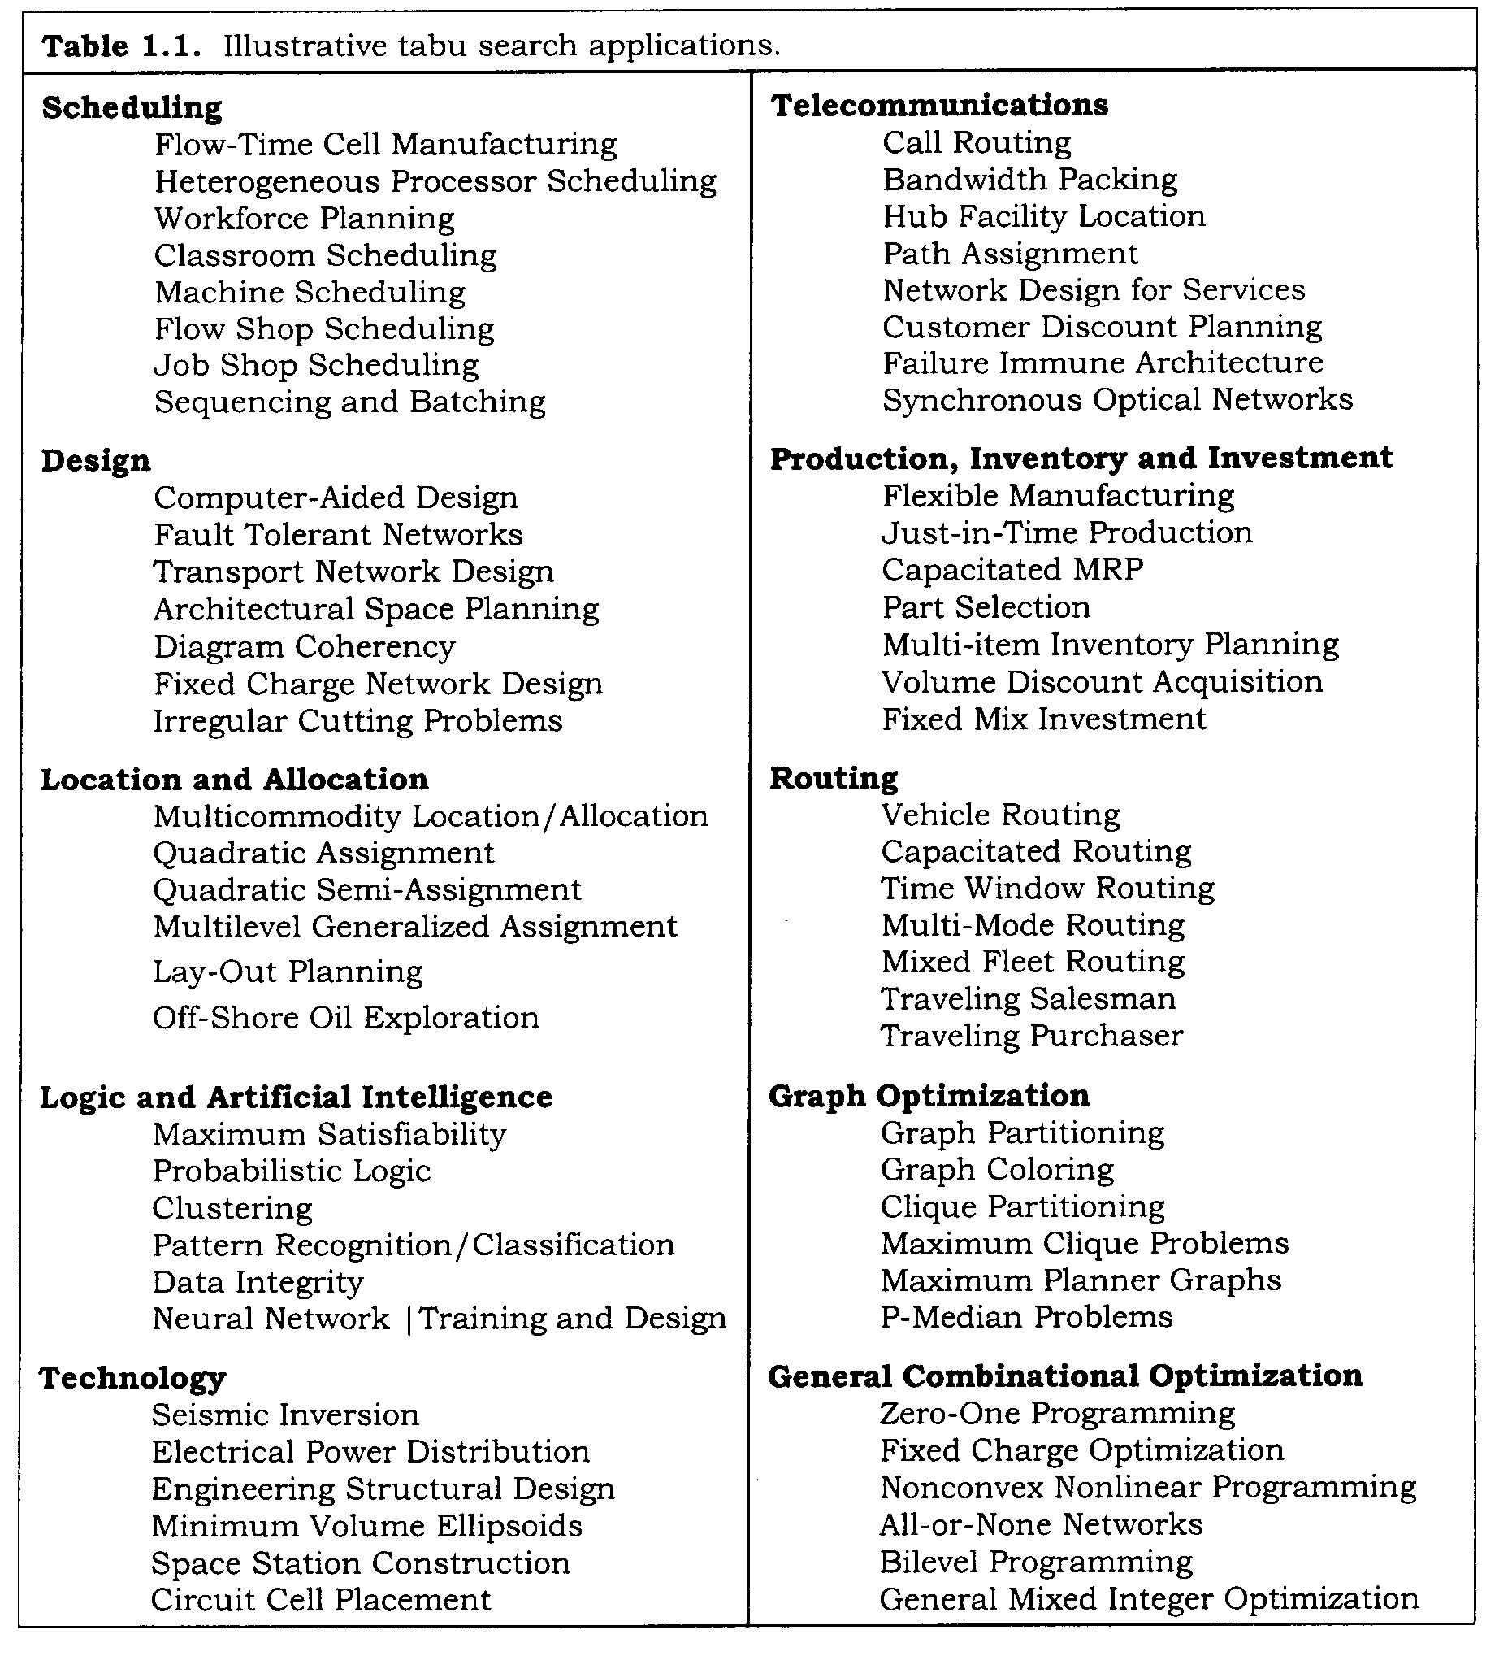
TS applications

Slide 7
Four dimensions of TS memory
Recency based (short term) memory
Frequency based (long term) memory
Quality: ability to differenciate the merit of solutions
  Use memory to identify elements common to good solutions
  Reinforce (discourage) actions that lead to good (bad) solutions
Influence: impact of the choices made in search on both quality and structure of solutions

Slide 8
Use of memory in TS
Use of memory leads to learning
Memory in TS is explicit and attributive
Solution attributes (or elements or components) that change in moving from one solution to another are recorded for guiding the search
Attributes can be nodes or arcs repositioned in a graph or job indeces in scheduling
In addition to recency or frequency of solution attributes, elite solutions and their attractive neighbors are explicitely recorded

Slide 9

Intensification and diversification
Intensification: a form of exploitation
  Based on modifying choice rules to encourage good move combinations and solution attributes
  May lead to return to attractive regions
  Examines neighbors of prerecorded elite solutions
Diversification: a form of exploration
  Examines unvisited regions, generates different solutions

Slide 10

Problem definition
Suppose we have the (conceptual) problem
min or max f(x)
subject to
where X is the set of constraints
Both f(x) and the constraints can be nonlinear
Neither has to be explicit mathematical formulations

Slide 11





Neighborhood search in TS
Let be the neighborhood of
Start by moving from to
Repeat this a number of times until a termination condition is satisfied
Choose in a systematic manner rather than randomly
May use a candidate list (as in candidate subgraph for TSP) to narrow down search in

Slide 12


Dynamic neighborhood
Use recency based (short term) memory to obtain
by eliminating (making tabu) the recently visited solutions in order to avoid cycling
Use frequency based (long term) memory and elite solutions to obtain in order to expand the neighborhood and examine unvisited regions

Slide 13

Recency based memory
Recency based memory records solution attributes (or elements or components) that have changed “recently”
Selected attributes in recently visited solutions become tabu-active during their tabu tenures
Solutions containing these attributes are classified as tabu
Tabu solutions are excluded from and not revisited during the tabu tenure (a certain period of time = certain number of moves)

Slide 14
Aspiration criteria
Improved-best or best solution criterion: If a tabu solution encountered at the current iteration is better than the best solution found so far, then its tabu status is overridden
Other aspiration criteria are possible, e.g. setting the tabu tenure shorter for better solutions

Slide 15
Example 1: Ordering of modules
Problem definition: Find the ordering of modules (filters) that maximizes the overall insulating property of the composite material
Representation of a solution for 7 modules:
Neighborhood structure: swapping modules
A solution has 21 neighbors (7 choose 2)
2 5 7 3 4 6 1
2 6 7 3 4 5 1

Slide 16
Example 1: Recency based memory and tabu classification
Tabu attributes are selected as most recently made swaps
Tabu tenure is set as 3 iterations
Hence, solutions involving 3 most recent swaps will be classified as tabu
Aspiration criterion is chosen as best solution

Slide 17
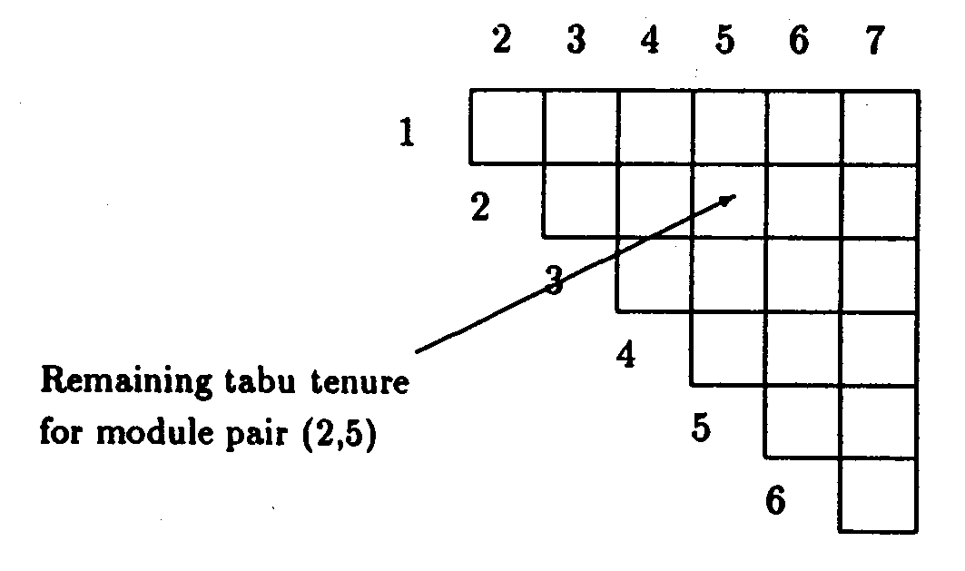
Example 1: Initialization of recency based memory
An upper triangle is enough

Slide 18
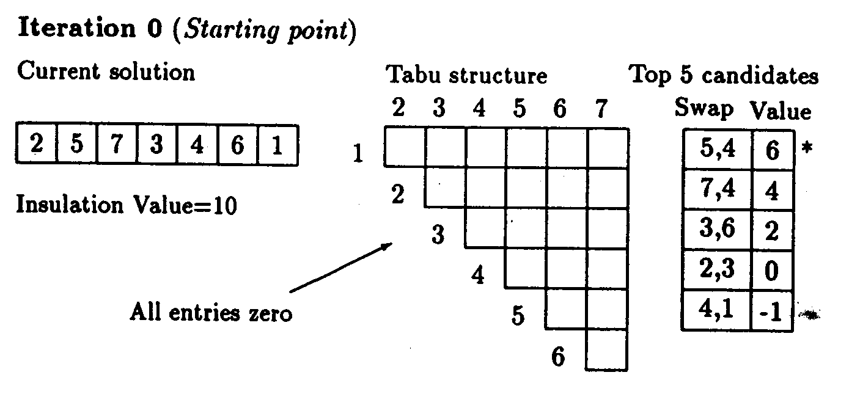
Example 1: Iteration 0
Top 5 candidates constitute the candidate list
“Value” is the gain of swap

Slide 19
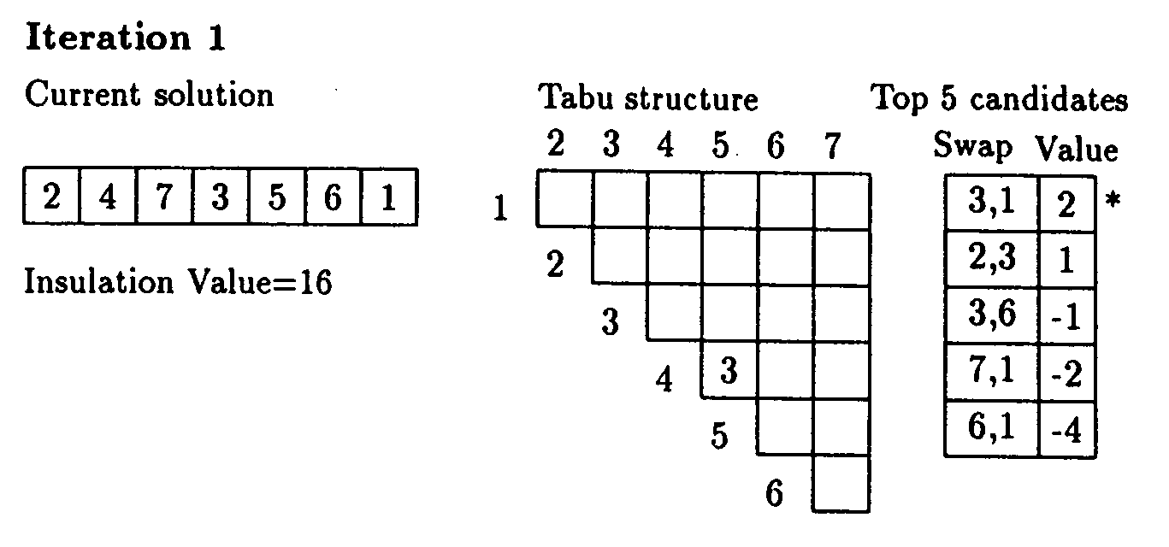
Example 1: Iteration 1
Move (4,5) has now a tabu tenure of 3 iterations

Slide 20
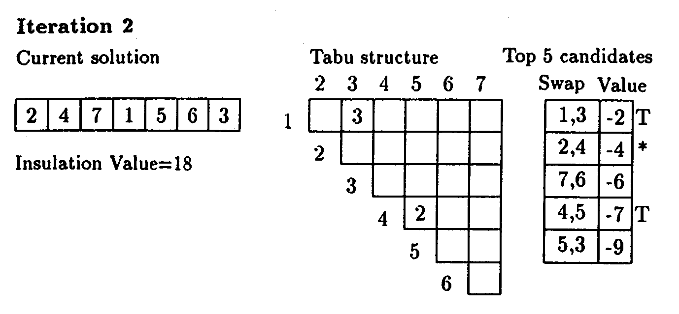
Example 1: Iteration 2
Moves (1,3) and (4,5) have respective tabu tenures 3 and 2
No move with a positive gain, hence best (non-tabu) move will be non-improving

Slide 21
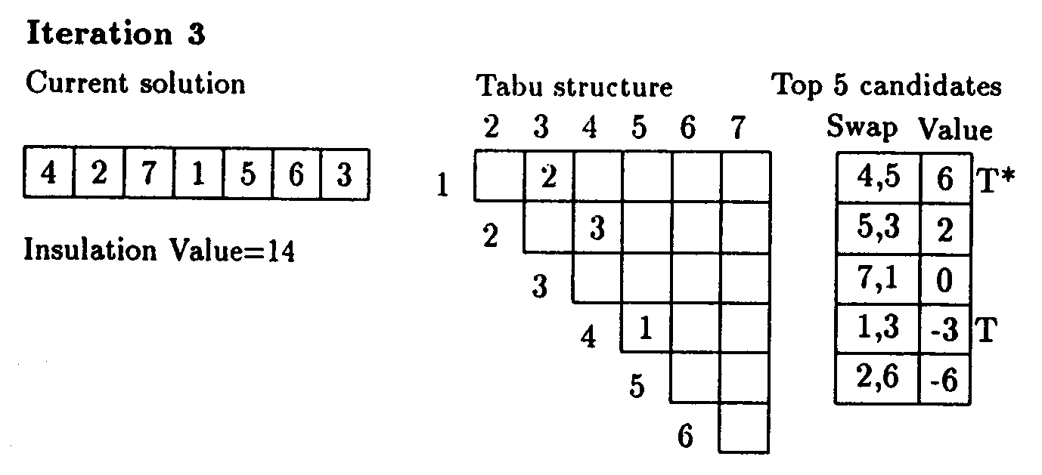
Example 1: Iteration 3
Move (4,5) has a tabu tenure of 1 iteration
But this move results in the best solution so far
Hence its tabu status is overridden

Slide 22
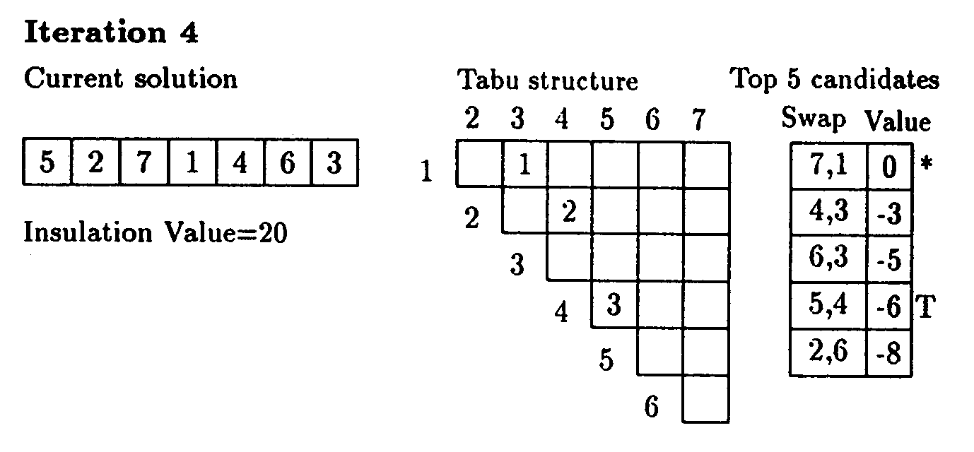
Example 1: Iteration 4
Best move is (1,7)

Slide 23
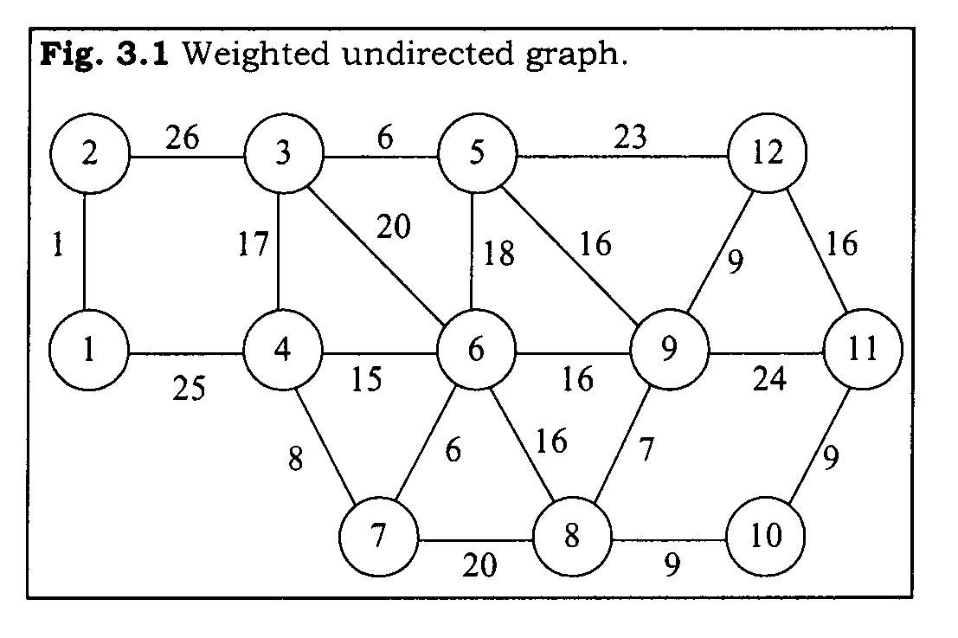
Example 2: Minimum k-tree
Problem definition: Find the tree consisting of k-edges in a graph such that the sum of the edge weights is minimum

Slide 24
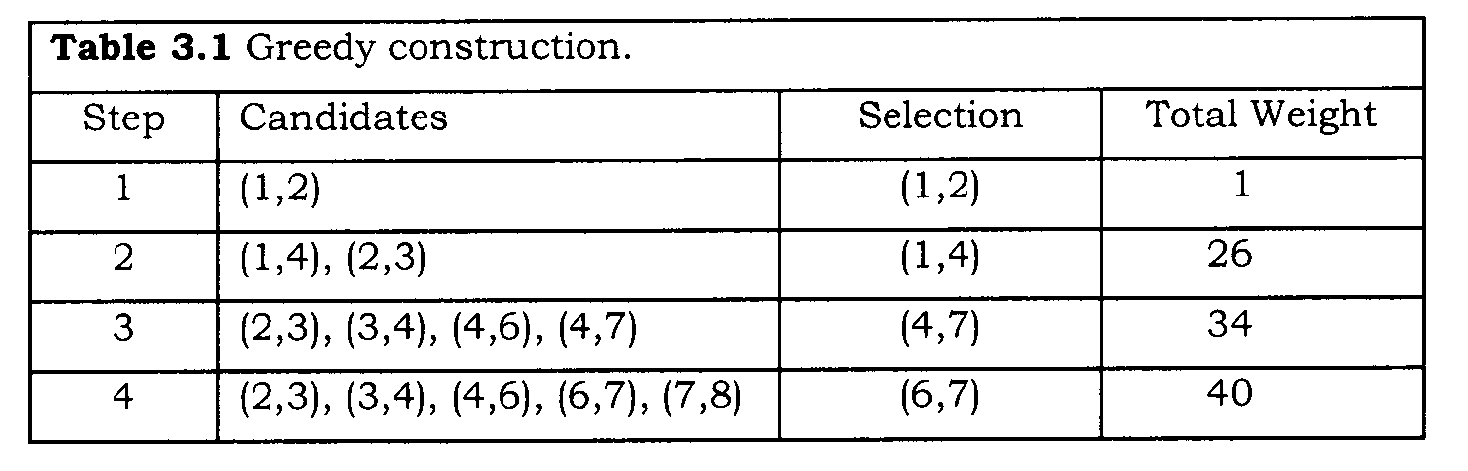
Example 2: Greedy construction of initial k-tree (k=4)
Start with the edge having the minimum weight
Choose remaining k-1 edges successively to minimize the increase in total weight in each step

Slide 25
Example 2: Neighborhood structure
Basic move is edge swapping
Consider all feasible swaps that result in a tree and that are not tabu (in general, infeasible moves may be allowed occasionally)
Choose the move yielding the minimum total weight
A static swap keeps current nodes, a dynamic one allows change of nodes

Slide 26
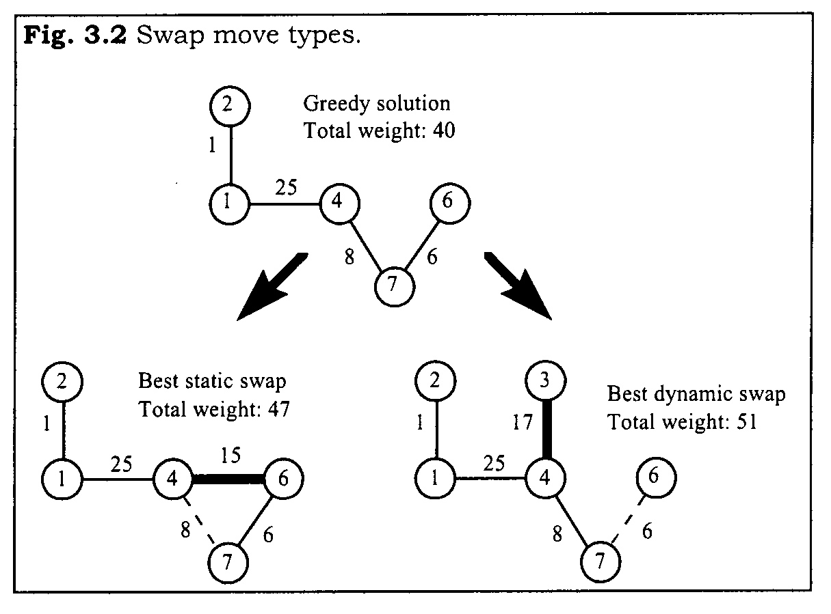
Example 2: Neighborhood structure (cont.)
Static swap is selected

Slide 27
Example 2: Tabu classification
Tabu attributes are edges swapped
Out-edge is {4,7}, in-edge is {4,6} in Figure 3.2
Tabu tenure for in-edges (bounded by k) is set as 1
Tabu tenure for out-edges is chosen as 2 (since there are more outside edges)
A swap move is classified as tabu if either the out-edge or the in-edge involved is tabu-active (an alternative rule could have been “if both are tabu-active”)

Slide 28
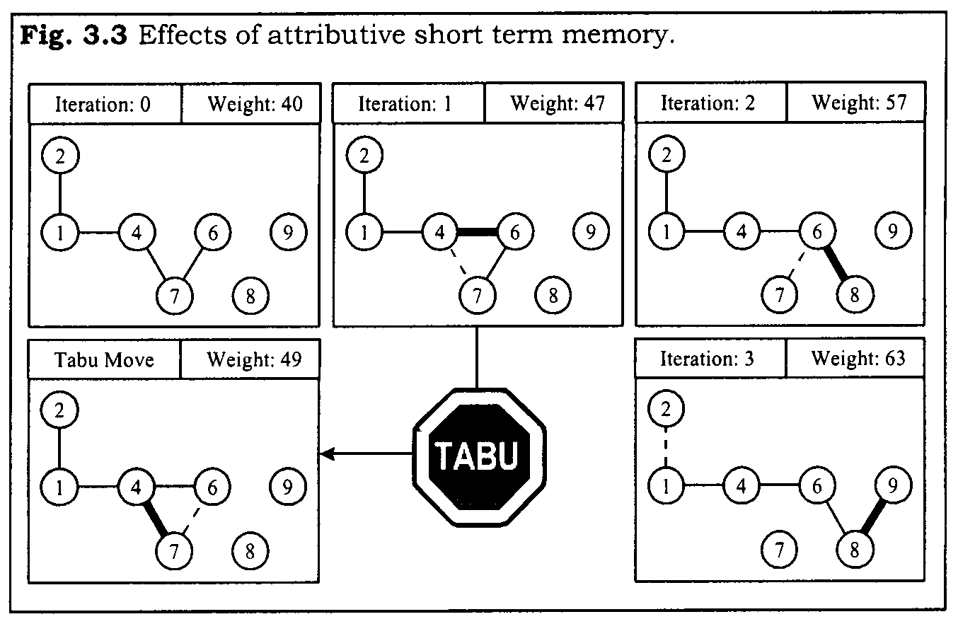


Example 2: Tabu classification may prevent visiting unexamined solutions
In iteration 2, in-edge {4,7} and out-edge {6,7} with objective function value 49 cannot be visited since {4,7} is tabu-active, and we end up with an inferior solution

Slide 29
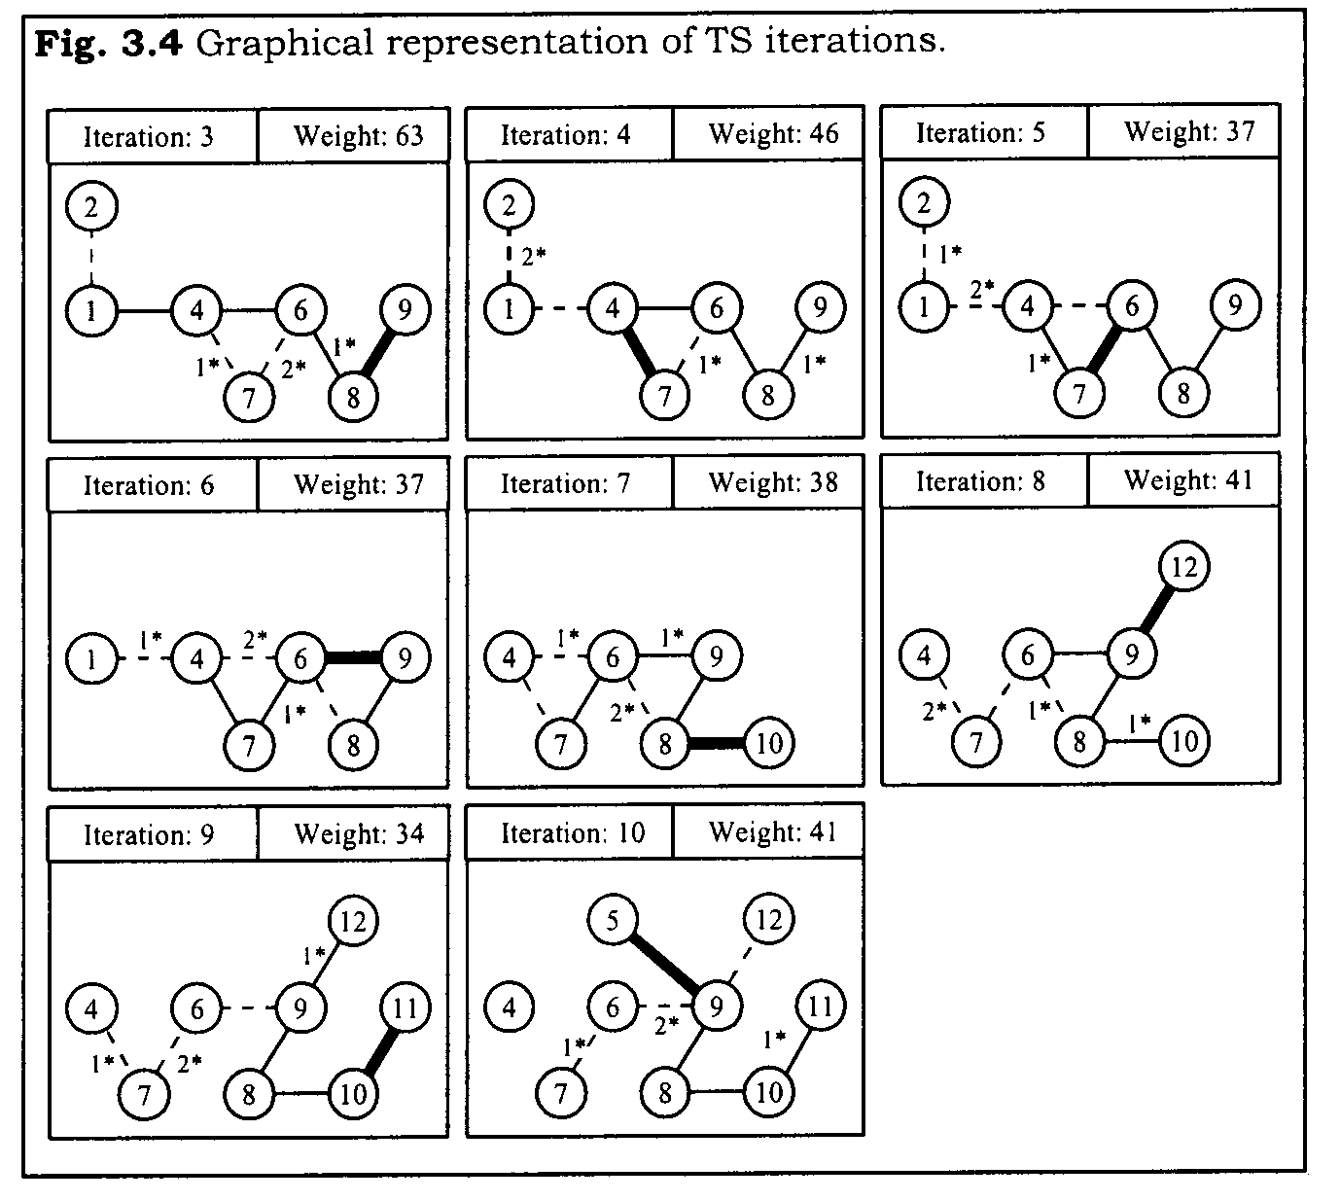
Example 2: Additional iterations
34 is the
optimal
solution

Slide 30
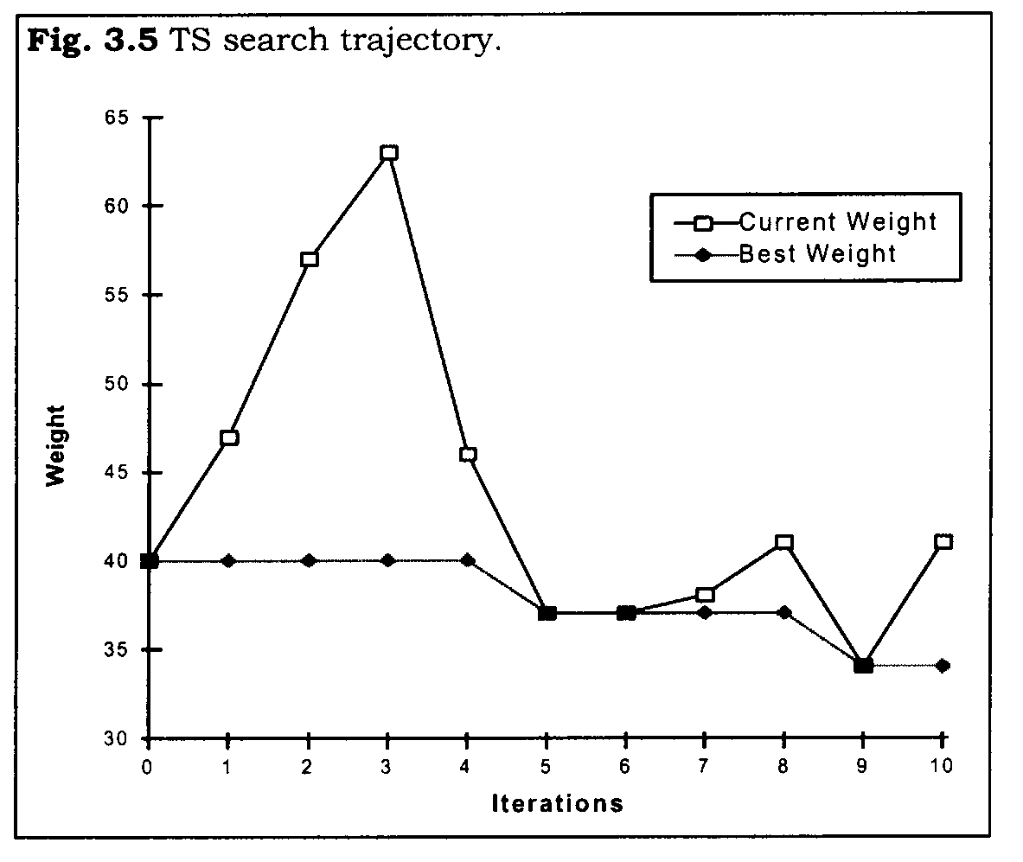
Example 2: TS search trajectory
Note the local optima in iterations 5 and 6

Slide 31
Diversification or restart in TS
We may need to diversify or restart TS when, for example, no admissible improving moves exist or rate of finding new best solutions drops
Instead of choosing the restarting point randomly, TS employs diversification strategies based on:
  Frequency based memory: records frequently used attributes or visited solutions
  Critical event memory: an aggregate summary of critical events (local optima or elite solutons) during the search

Slide 32
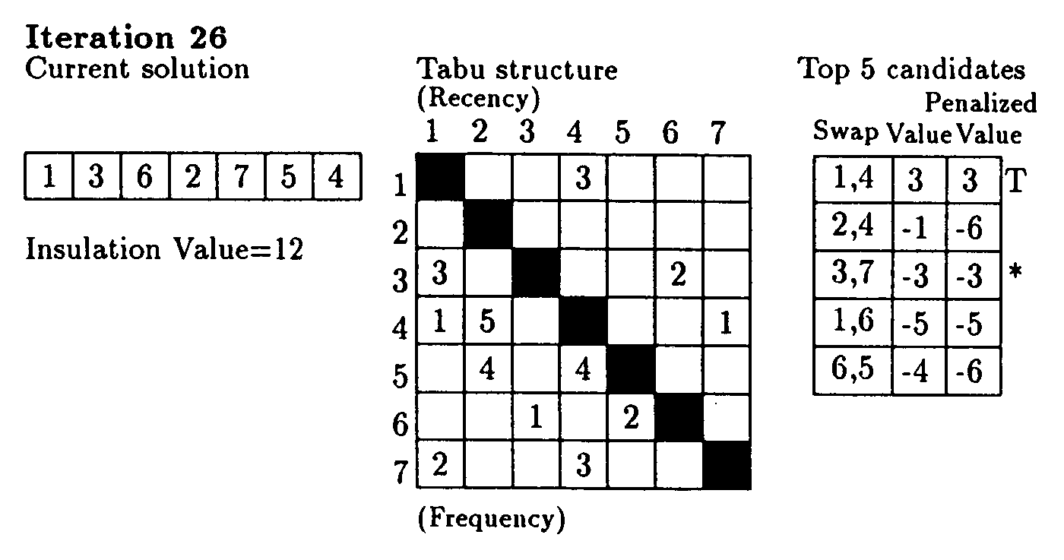
Example 1: Diversification using frequency based memory
Diversify when no admissible improving moves exist
Penalize non-improving moves by assigning larger penalty to more frequent swaps, choose (3,7) using penalized value

Slide 33
Example 2: Diversification using critical event memory
Summary of the starting solution and local optima (elite solutions) found in previous start(s)
Assuming we choose to restart after iteration 7, these are the starting solution (40), and solutions found in iterations 5 (37) and 6 (37)
In finding the restarting solution, penalize the use of edges in these solutions for diversification
May use frequency based memory (frequency of appearance of these edges) for weighing the edges

Slide 34
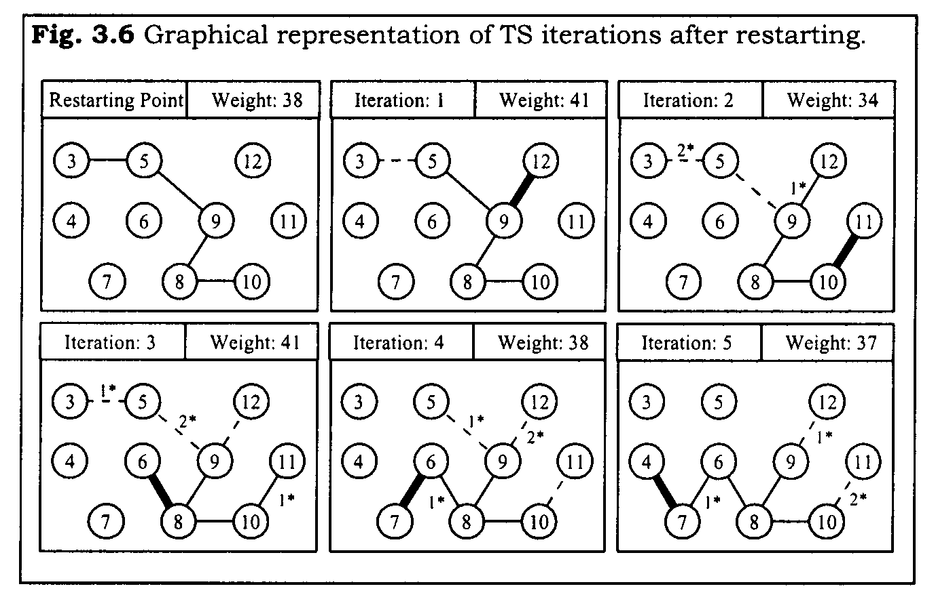
Example 2: Restart iterations

Slide 35







A TS Algorithm
Find an initial solution , set , initialize memory
Intensification phase:
  2.1 If termination condition (e.g. simple iteration count, no admissible improving move, no change in in so many iterations) is satisfied, then go to step 3
  2.2 Choose such that is not tabu or satisfies aspiration criterion
  2.3 Move from to , i.e. set

Slide 36

A TS algorithm (cont.)
  2.4 If is better than , then set
  2.5 Update recency based memory (tabu classifications), frequency based memory and/or critical event memory (elite solutions), return to step 2.1
Diversification phase:
  3.1 If termination condition is satisfied, then stop
  3.2 Using frequency based memory and/or critical event memory, find a new starting point , return to step 2

Slide 37
TS decisions
Neighborhood structure (basic move, candidate list)
Recency based memory
Intensification strategy
  Tabu attribute(s)
  Tabu tenure(s)
  Tabu classification of a solution (as a function of tabu attributes)

Slide 38
TS decisions (cont.)
Aspiration criterion
Frequency based memory and/or critical event memory (summary of elite solutions)
Diversification strategy
Termination conditions for intensification and diversification phases

Slide 39
Tabu Search (cont.)
Glover and Laguna, Chapter 3 in Reeves, Modern Heuristic Techniques for Combinatorial Problems, Wiley, 1993
Section 3.2.5 and on

Slide 40
TS Algorithm
Find an initial solution , set , initialize memory
Intensification phase:
  2.1 If termination condition (e.g. simple iteration count, no admissible improving move, no change in in so many iterations) is satisfied, then go to step 3
  2.2 Choose such that is not tabu or satisfies aspiration criterion
  2.3 Move from to , i.e. set

Slide 41
TS algorithm (cont.)
  2.4 If is better than , then set
  2.5 Update recency based memory (tabu classifications), frequency based memory and/or critical event memory (elite solutions), return to step 2.1
Diversification phase:
  3.1 If termination condition is satisfied, then stop
  3.2 Using frequency based memory and/or critical event memory, find a new starting point , return to step 2

Slide 42
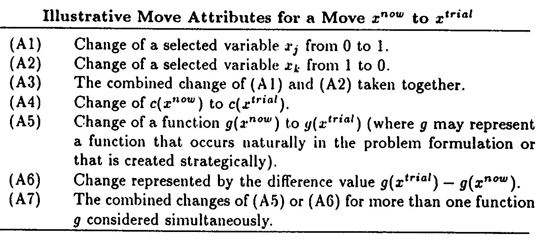
Move attributes

Slide 43
Move attributes (cont.)
x^{trial} is the potential x^{next} we are considering
Setting a solution variable x_{j} to 1/0 may mean adding/deleting a node or an edge to/from a graph, or assigning/removing a facility to/from a location
A move can be devised based on multiple solution attributes as in (A3)
Function g may be completely independent of objective function c, e.g. the distance (dissimilarity) between x^{trial} and x^{best}, or x^{trial} and the last local optimum visited

Slide 44

Move attributes (cont.)
In some cases, move attributes can be classified as from-attributes and to-attributes, i.e.
from-attribute A(x^{now}) - A(x^{trial})
to-attribute A(x^{trial}) - A(x^{now})
where A is the set of attributes of a solution
For example, if x_{ij}=1 indicates that facility i is assigned to location j, then in the move setting x_{ij}=0 and x_{ik}=1, x_{ij} is the from-attribute and x_{ik} is the to-attribute

Slide 45
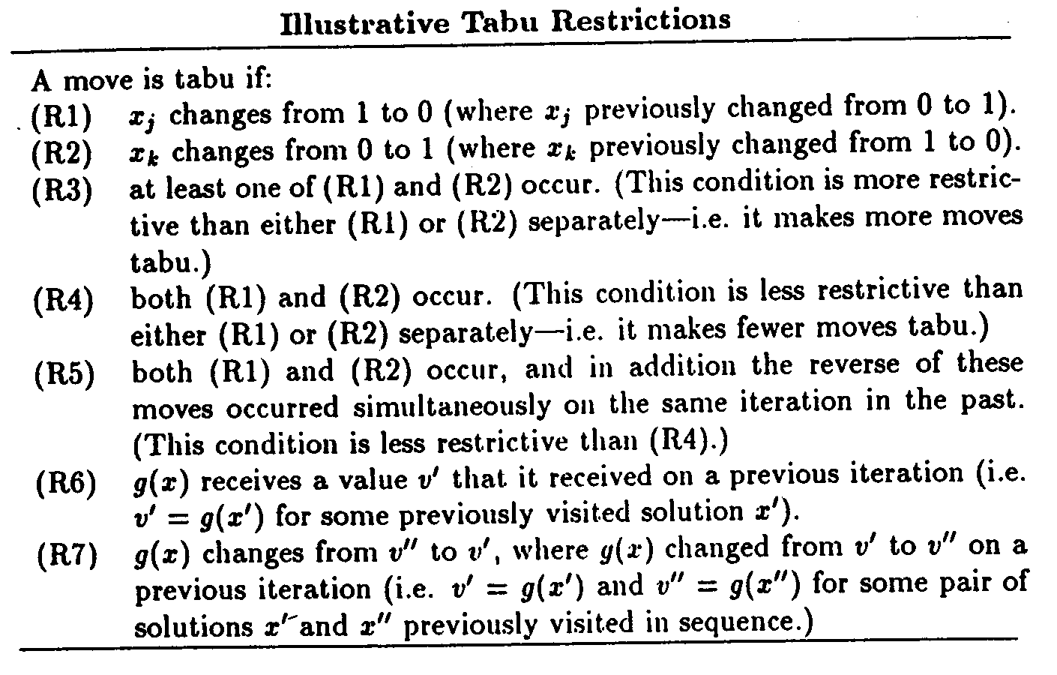
Tabu restrictions

Slide 46
Tabu restrictions (cont.)
Tabu restrictions are used to avoid reversals or repetitions (cycling)
As long as at least one to-attribute of a current move is different from a from-attribute of a previous move, cycing cannot occur
Revisiting a solution encountered before may still be possible in the long run
Tabu tenures may be based on recency or frequency

Slide 47



Recency based tabu restrictions
Different attributes may have different tabu tenures, e.g. in-edges and out-edges in the k-tree problem or TSP
Tabu tenures can be static, e.g. a constant or
Tabu tenures can also be set dynamically within a range, e.g. they may vary between
and

Slide 48
Recency based tabu restrictions (cont.)
Tabu tenures can be dynamic depending on both type and quality of an attribute (keep a good attribute longer)
Experience shows that dynamic rules are more robust than static rules
Attribute-dependent dynamic rules have proved effective for difficult problems (scheduling and routing)

Slide 49
Aspiration criteria
Aspiration criteria are based on influence, which measures the degree of change in solution structure, quality, or feasibility
Influence is often associated with move distance
High-influence moves must be given priority in the absence of improving moves (indication of getting stuck in local optima)

Slide 50
Types of aspiration criteria
There are two types of aspirations
  Move aspiration: revokes solution’s tabu classification
  Attribute aspiration: revokes attribute’s tabu-active status
Aspiration by default: If all available moves are tabu, then select the least tabu one
Aspiration by objective: Revoke tabu classification of x^{trial}, if x^{trial} is better than x^{best}

Slide 51
Types of aspiration criteria (cont.)
Aspiration by search direction: Revoke tabu-active status of an attribute, if direction indicated by the attribute is improving and x^{trial} is better than x^{now}
Aspiration by influence: Revoke tabu-active status of an attribute, if it is associated with a low-influence move, and a high-influence move has been performed since it has been tabu-active (hence cycling is unlikely)

Slide 52
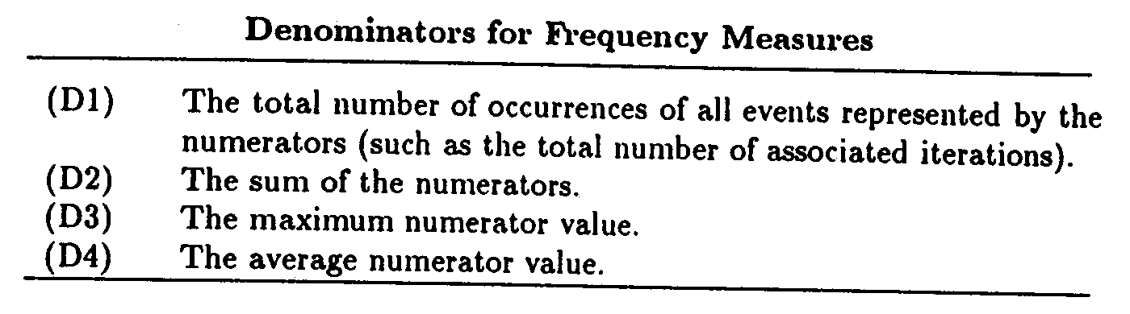
Mesures for frequency based memory
In general, a ratio where the numerator is
the number of occurences of a particular event

Slide 53
Mesures for frequency based memory (cont.)
The numerator can be the number of times
a solution has appeared
a move attribute has appeared
a from-attribute has appeared
a to-attribute has appeared
over the solutions visited so far

Slide 54
Types of frequency
Residence frequency: Number of times a particular value of an attribute resides in the solution; high frequency in good solutions may indicate a highly attractive attribute, or vice versa
Transition frequency: Number of times an attribute changes from a particular value and/or to a particular value; high frequency may indicate the attribute is in and out of solution for fine tuning

Slide 55
Use of frequency based memory
Attributes with higher frequency may also become tabu-active just as those having greater recency
However, frequency based memory is typically used
  To define penalty and incentives in evaluating moves (as in Example 1)
  For long term diversification

Slide 56
Intensification vs Diversification
Intensification encourages incorporation of good attributes
  Short term: incorporate attributes receiving highest evaluations
  Long term: incorporate attributes from a small subset of elite solutions easily reachable from each other
Diversification seeks different solutions
  Consider, for example, using all local optima distributed across the entire search space

Slide 57
TS algorithm revisited
Note that intensification and diversification are in fact not entirely separated in TS
In step 2 (intensification phase), some short term diversification may take place, e.g. penalize frequent moves as in Example 1
In step 3 (diversification phase), some long term intensification may take place, e.g. assign incentives (instead of penalties) to elite solutions to find a restarting point in Example 2

Slide 58
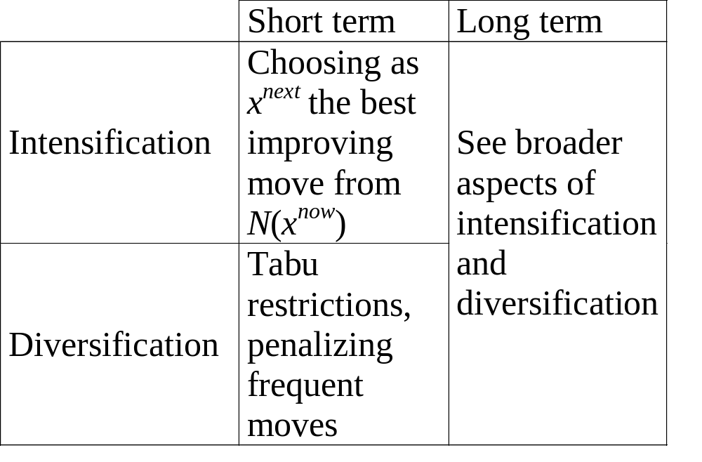
TS algorithm revisited (cont.)

Slide 59
Broader aspects of intensification and diversification
TS hypotesis: systematic diversification is better than random search
We are interested in not only a diversified collection of solutions but also a diversified sequence of solutions
To create a diversified sequence, we can use a metric that maximizes the distance between solutions in terms of from- and to-attributes (solution structure)

Slide 60

Broader aspects of intensification and diversification (cont.)
Z(k)={z(1),z(2),...,z(k)} is a diversified sequence of solutions, relative to distance metric d by requiring each subsequence Z(h) of Z(k), h<k, and each associated point z=z(h+1) to satisfy the following hierarchy of conditions:
(A) z maximizes the minimum distance d(z,z(i)) for i h
subject to (A), z maximizes the minimum distance d(z,z(i)) for 1<i h, then for 2<i h,..., etc. (in strict priority order in case of ties)
subject to (A) and (B), z maximizes the distance d(z,z(i)) for i=h, then for i=h-1,..., and finally for i=1.

Slide 61
Mechanisms of intensification and diversification
Penalty and incentive functions
Reinforcement by restriction
Path relinking
Variations of path relinking: tunneling and extrapolated relinking
Solutions evaluated but not visited
Creating new attributes
Strategic oscillation

Slide 62
Penalty and incentive functions
Assign penalties to frequent moves for diversification
Assign incentives to elite solutions for intensification
Interval specific penalties and incentives, e.g.
  Classify move evaluations into improving and nonimproving intervals, assign penalties (incentives) to those in nonimproving (improving) interval
  Classify move evaluations into high and low influence intervals, reduce or cancel incentives accordingly

Slide 63
Reinforcement by restriction
If a few attribute values have a high frequency, then explicitely restrict moves to take on those attribute values, i.e. fix certain attributes
Restricts solution space and simplifies some problems
Restricting some attributes (intensification) allows better exploration of remaining attributes (diversification) within limited computation time

Slide 64


Path relinking
Given two selected elite solutions and , generate a path (a sequence of moves) to reach from
At each step, choose a move that leaves the fewest number of moves remaining to reach
If and share more (fewer) attributes, then path relinking serves intensification (diversification)

Slide 65
Variations of path relinking
Tunneling: Proceed from both and (occasionally allow infeasible moves)
This basically corresponds to exchanging components of two solutions
Extrapolated relinking: Do not stop when you reach but go beyod it for further diversification

Slide 66
Solutions evaluated but not visited
Count the number of times an attribute is considered in x^{trial}, even though x^{trial} is not actually visited
Give incentive to an attribute that has a high count above, but that has a low frequency over actually visited solutions, to be incorporated into future moves
Here, recency and frequency interact, serving both intensification and diversification simultaneously

Slide 67
Creating new attributes
Create new attributes by implicitly combining or subdividing existing attributes
Vocabulary building: Discover attribute combinations (vectors) shared by various solutions, e.g. a subpath in TSP or a partial sequence in scheduling (similar to building sentences from words)
If necessary fill in the blanks in these vectors to obtain unvisited feasible solutions

Slide 68
Strategic oscillation
Move until hitting a boundary, e.g. infeasibility
Instead of stopping there, extend neighborhood definition or modify evaluation criteria for selecting moves, to permit crossing of the boundary
Proceed for a specified depth beyond the boundary, then turn around and cross the boundary in reverse direction
This way, explore the boundary of feasibility better, where the global optimum is likely to be found
SO may also take place at a region searched intensely

